Slide 1

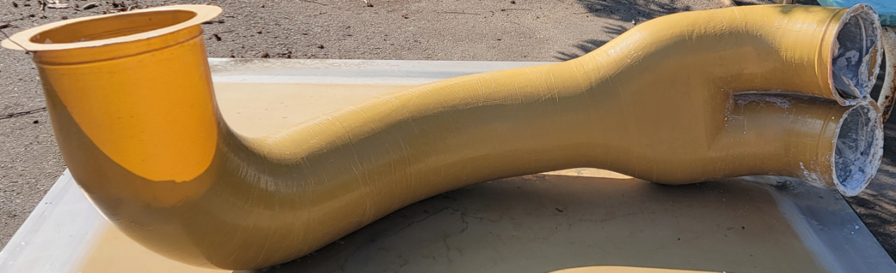
- RAPID PRODUCTION OF WATER SOLUBLE CORES -
Water soluble mandrels are more and more in demand. It is an easy way to fabricate
complex and seamless composite parts.
SOLTEC developed a unique rapid production method of mandrels. SOLTEC mandrels are
produced faster, less expensive and in almost any sizes with tight tolerances in comparison to other mandrel fabricators. Many of our customers started to use mandrels from other water mandrel producers but changed vendors after having many issues with their former mandrel suppliers. We are proud to be part of the tooling department for many OEMs and composite aerospace fabricators. We are part of the prototype development to the serial production of mandrels for many existing and future aircraft. Our mandrels range in size from a few inches up to 15ft. The mandrels can be exposed to high temperatures and pressures making autoclave applications possible. The dimensional stability of mandrels is absolutely leading in the industry and beside the delivery time and process one of the main reasons why customers change to our rapid mandrel fabrication.

Slide 2
- RAPID PRODUCTION OF WATER SOLUBLE CORES -
MANDREL PROPERTIES/SUPPLIERS | Competitors (ExOne, ACM etc) | SOLTEC
- Size vs tolerances | +/-0.030” UP TO 30IN =/-0.060” up to 100in | +/- 0.010” up to 60in CMM +/- 0.030” up to 15ft
- Surface finish – dimensional stability | - Potential of deformation and surface issues | - Great dimensional stability and superior surface finish
- Delivery time vs quantity | 4-6 weeks for 1 mandrel Up to 3 mandrels per week | 1-2 weeks for first mandrel Up to 50 mandrels per week
- Mandrel prices | - 1 x Prototype = 50% less expensive than SOLTEC | More than 2 x mandrels, prices normally reduce by 50 to 75%
- Wash-out of mandrel | Same | Same

Slide 3
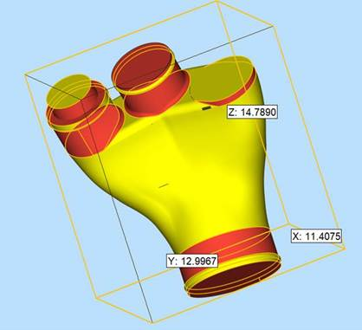
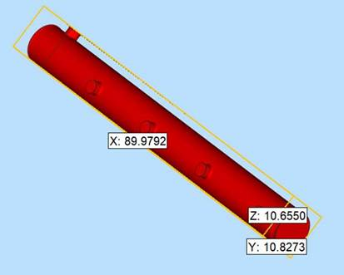
- RAPID PRODUCTION OF WATER SOLUBLE CORES -

Slide 4
- RAPID PRODUCTION OF WATER SOLUBLE CORES -

Slide 5
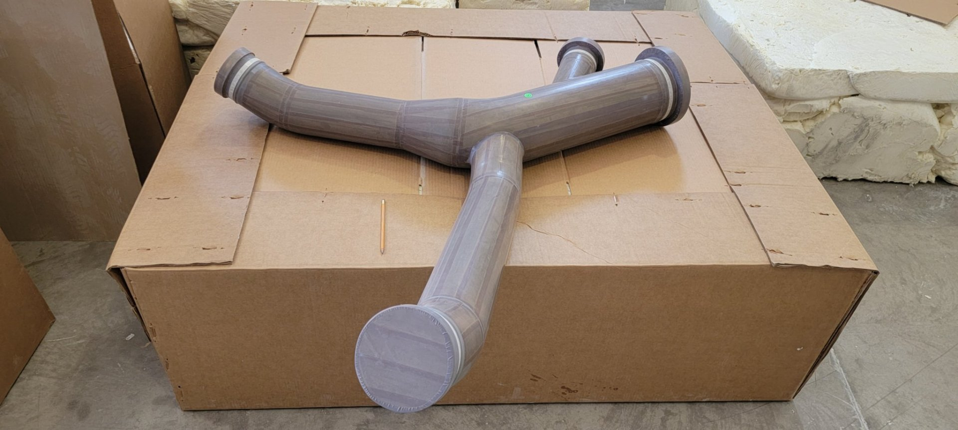
- RAPID PRODUCTION OF WATER SOLUBLE CORES -

Slide 6
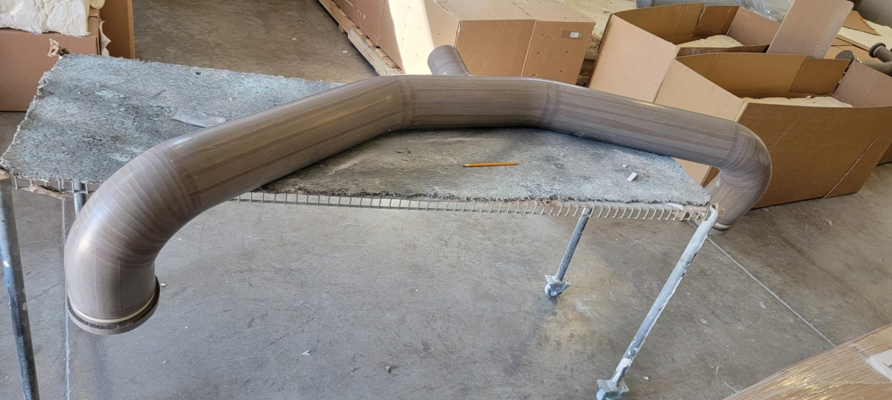
- RAPID PRODUCTION OF WATER SOLUBLE CORES -

Slide 7
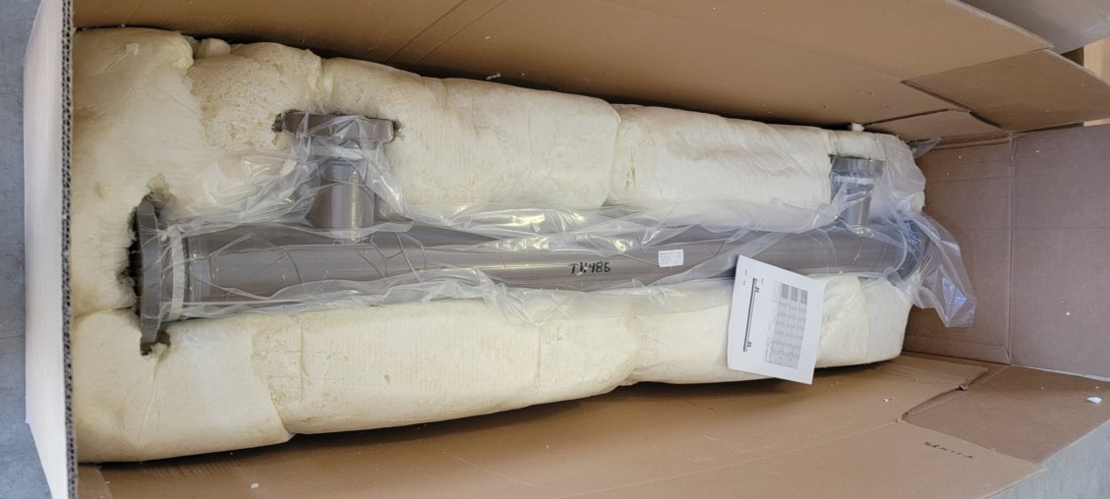
- RAPID PRODUCTION OF WATER SOLUBLE CORES -

Slide 8
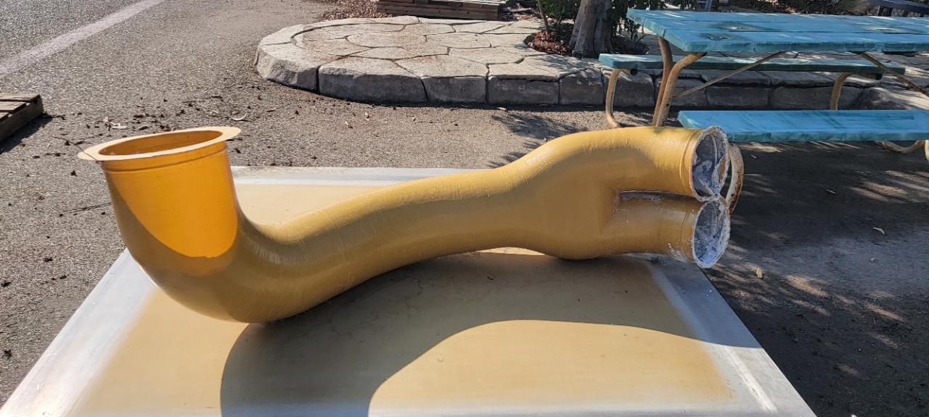
- RAPID PRODUCTION OF WATER SOLUBLE CORES -

